Slide 1
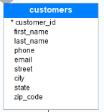
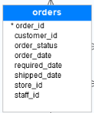
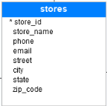
Database Tables
A database most often contains one or more tables. Each table is identified by a name (e.g. "Customers" or "Orders"). Tables contain records (rows) with data.
Database

Slide 2

Database Tables
SELECT - extracts data from a database
UPDATE - updates data in a database
DELETE - deletes data from a database
INSERT INTO - inserts new data into a database
CREATE DATABASE - creates a new database
ALTER DATABASE - modifies a database
CREATE TABLE - creates a new table
ALTER TABLE - modifies a table
DROP TABLE - deletes a table
CREATE INDEX - creates an index (search key)
DROP INDEX - deletes an index
Employee

